Slide 1
PE REST API
IBM Enterprise Content Management Software
IBM Software Solutions | Enterprise Content Management Software

Slide 2
Overview
The presentation introduces the Process Engine REST services for IBM Case Manager
The PE REST API was available in P8 4.5.1 and enhanced in 5.0, primarily to support Case Manager.

Slide 3
IBM Case Manager REST services
Browser
Client
HTTP
XML/JSON
Integration Tier - WebSphere Application Server
Process Engine
REST
(PE REST)
Case Management
REST
(Case REST)
Content Management Interoperability Service (CMIS)
Process Engine Java API
Content Engine Java API
P8 Engine
Process
Engine
Content
Engine
Case Manager includes three REST services that are used together to access and manipulate cases

Slide 4
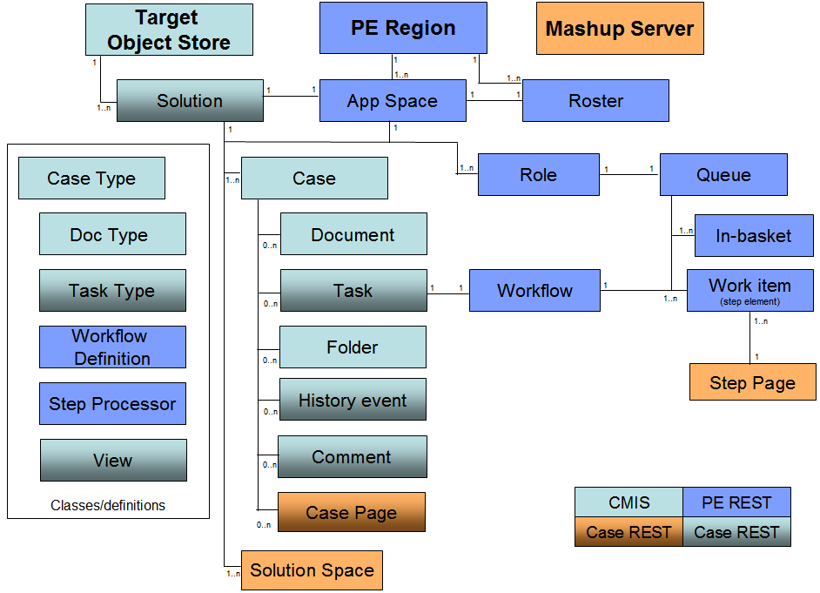
Deployed Solution: focusing here on blue boxes
Changes to the above for ICM 5.1:
Case, Case Type, and Doc Type can now be manipulated by Case REST API
Mashup Server is now Business Space

Slide 5


PE REST Service: Overview
Enables lightweight clients (such as Javascript/Ajax-based applications) to access PE resources over HTTP
Uses the HTTP query string format for both request and response data
JavaScript Object Notation (JSON) is used as the data-interchange format
Requests are made in the form of a URL, optionally passing a JSON file with data
Applications can use the PE REST Service to perform fundamental PE operations; e.g.:
  Launch and modify workflows
  Update participant roles
  Retrieve information about participants and their assigned work items

Slide 6
PE REST Service: What was New in P8 5.0
New Resources:
  Application Space Names (get names of deployed solutions)
  Writable Application Space
  Writable Application Spaces
  Security Domains (list of LDAP realms)
  Groups (LDAP search)
  Role Names (within an Application Space)
  Writable Application Space Role
  Writable Application Space Roles
  Writable Application Space Role Members (users or groups)
  Writable Application Space Role Members Update
  Users (LDAP search)
  Workbasket Column Attributes
The “Writable” resources are similar to others listed, but can only be run against objects that the current user can modify

Slide 7
PE REST Service: What was New in P8 5.0 (cont.)
New Parameters or Values for Existing Resources:
  Workbasket resource: New includeCustomAttributes parameter returns in-basket custom attributes in a single call.
  Queue Elements: New queryFlags value (16384) to specify a descending sort.
  Step Element resource, PUT parameters:
    New action parameter value, returnToSource. Returns the work item to the queue from which a user originally reassigned or delegated the work item
    New action parameter value, reassign. Reassigns the participant responsible for processing the step. This value has a number of qualifying parameters available.
    New action parameter value, moveToInbox. Moves the work item to the inbox of the current user.
Additional Functionality:
  New Optional URI parameter cp=connectionPointName
    specify this for any resource to override the connection point setting assigned in the P8BPMRESTConfig.xml file.

Slide 8
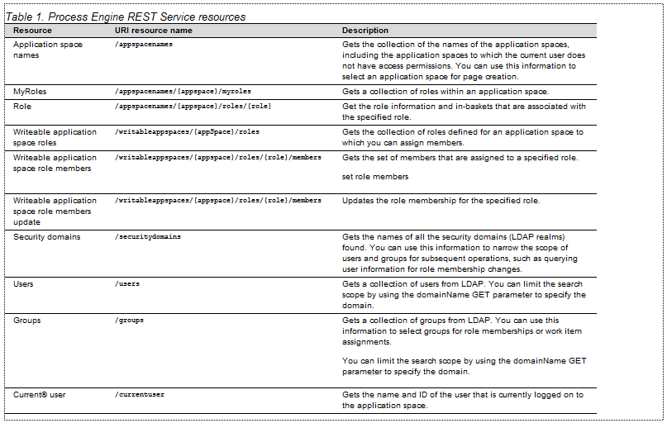
PE REST: Resources that were new in 5.0
These new resources are oriented around Case Management specifically
We are focusing on these in this workshop

Slide 9
PE REST
These are mostly unchanged since 4.5.1 and not the focus of this workshop
There are code examples in redbook cited in References
(Terminology: work class = workflow; workbasket = in-basket)
  Launch a workflow
  Get queue elements
  Get queue elements count
  Get application space roles
  Get role definition
  Retrieve step element
  Update step element
  Get queue workbasket definition
  Get queue workbasket attributes
  Get workbasket column definitions
  Get workbasket filter definitions
  Get workbasket filter attributes
  Get work classes collection
  Get work class definition

Slide 10
PE REST: URI Format
The base URI for all PE REST resources is:
http://host:port/{context}/{servlet}/p8/bpm/v1/
  Typical values:
    Port = 9080 (WebSphere CE port for WSI communication)
    Context = CaseManager (as named when deployed in WebSphere); however, if P8 is installed without Case Manager, you would need to use WorkplaceXT as the context; if both are installed, either context is OK
    Servlet = P8BPMREST (from deployment descriptor of web application)
The rest of the URI:
{resourceName}[?cp={connectionPointName}][&{resourceParameters}]
  Typical values:
    Resource Name = appspacenames
    Connection Point Name = PECP1 (overrides configured value, if any)
    Resource Parameters = &parm1=value1&parm2=value2 ...
Simple full example:
http://icmlab1:9080/CaseManager/P8BPMREST/p8/bpm/v1/appspacenames?cp=PECP1

Slide 11
PE REST Resources - application spaces, roles, users and groups
Resource | Description
/appspacenames | GET – application spaces
/appspaces/{appspace}/myroles | GET – roles that logged on user is a member of
/appspaces/{appspace}/roles/{role} | GET – role info and in-baskets associated with this role
/writableappspaces/{appspace}/roles | GET – roles for assigning members to
/writableappspaces/{appspace}/roles/ {role}/members | GET – members (users and groups) in the role PUT – set role members
/securitydomains | GET – LDAP domains

Slide 12
PE REST Resources - application spaces, roles, users and groups
Resource | Description
/users | GET – users from LDAP (query parameters filter the list)
/groups | GET – groups from LDAP (query parameters filter the list)
/currentuser | GET – PE ID for logged on user

Slide 13
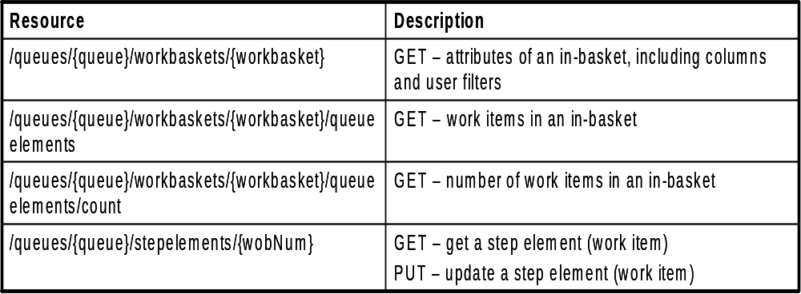
PE REST Resources – queues, in-baskets, work items

Slide 14

Example 1 – Finding the roles in a solution
Request (HTTP GET)
http://myserver:9080/CaseManager/P8BPMREST/p8/bpm/v1/appspaces/
Candidate%20Selection%202/myroles?cp=myCP
  Blanks are allowed, but here “%20” is used to represent them
Response (JSON)
{
"Customer Service Representative":{
"name":"Customer Service Representative",
"URI":"appspaces\/Dannay+Insurance+Claims\/roles\/Customer+Service+Representative"
},
"Adjuster":{
"name":"Adjuster",
"URI":"appspaces\/Dannay+Insurance+Claims\/roles\/Adjuster"
}

Slide 15
Example 2 – Retrieving work items in an in-basket for a role
First, list the in-baskets for the role (Clerk), using this resource:
/p8/bpm/v1/appspaces/{appspace}/roles/{role}
E.g. ... p8/bpm/v1/appspaces/Candidate%20Selection%202/roles/Clerk?cp=newportvm24_796_tos02 ...
2. From the response, get the URI for the in-basket
...
"workbaskets":{
"Clerk":{
"customAttributes":{
"CB_Inbasket":{
"value":"Candidate Selection 2",
"type":2,
"name":"CB_Inbasket",
"isArray":false
}
},
"name":"Clerk",
"URI":"queues\/CSLM2_Clerk\/workbaskets\/Clerk"
},
...
In-basket resource

Slide 16
Example 3 – Using Resource Parameters in a Group Search
We will use the “groups” resource
See the PE REST API Reference (in P8 5.1 Information Center) for full details on the parameters
The parameters here mean: find all groups with names beginning “CM”
Request (HTTP GET)
http://myserver:9080/CaseManager/P8BPMREST/p8/bpm/v1/groups?cp=PECP1 &searchPattern=CM&searchType=2
Response (JSON)
{"groups":[{"name":"CMAdmins","displayName":"CMAdmins"}, {"name":"CMInitiators","displayName":"CMInitiators"},{"name":"CMViewers","displayName":"CMViewers"},{"name":"CMWorkers","displayName":"CMWorkers"}],"overLimit":false}

Slide 17
References
Help in P8 5.1 Information Center:
  http://publib.boulder.ibm.com/infocenter/p8docs/v5r1m0/index.jsp
  “Developing IBM FileNet P8 applications” → “Process Engine Development” → “Process Engine REST Service”
  PE REST Service reference is at: http://publib.boulder.ibm.com/infocenter/p8docs/v5r1m0/index.jsp?topic=/com.ibm.p8.pe.dev.doc/rest/rest_ref.htm
Help in Case Manager 5.1 Information Center:
  http://publib.boulder.ibm.com/infocenter/casemgmt/v5r1m0/index.jsp
  “Developing case management applications” → “Managing workflows, roles, and in-baskets by using the Process Engine REST Service”

Slide 18
References
Because the PE REST API was initially shipped with P8 4.5.1, there is an additional resource:
  Redbook: “Developing Applications with IBM FileNet P8 APIs”, SG24-7743
    http://www.redbooks.ibm.com/redbooks/pdfs/sg247743.pdf
    Chapters 5 and 6 discuss introductory and advanced PE API Programming, with PE REST API discussions interspersed with those on PE Java API and PE Web Services
    Note that this is for P8 4.5.1 only, and therefore does not cover Case Management
    However, it does cover Eclipse setup for a PE REST development environment (albeit for 4.5.1), which this workshop does not address

